Slide 1
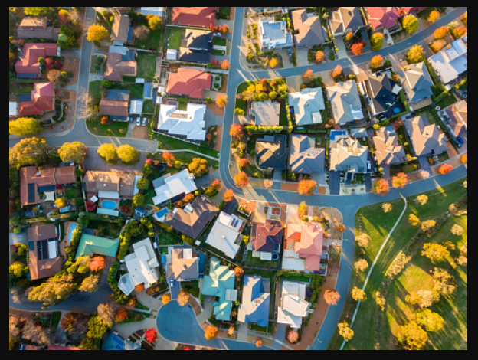
Token House
Your Solution to Decentralised Real Estate
Team members: Philippe, Michael, Julianne

Slide 2
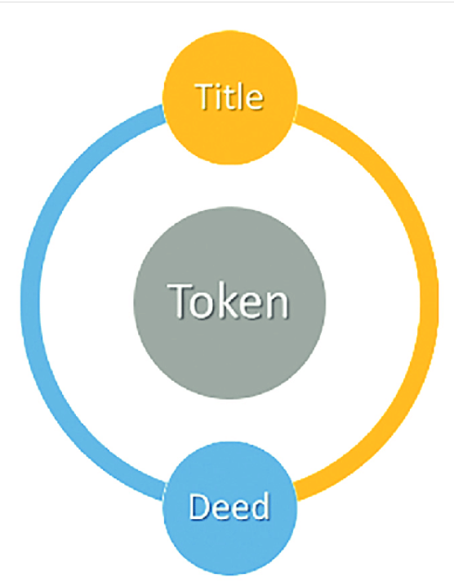
Executive Summary

Slide 3
Concept
Primary Objectives
Our Objective was to create a decentralized Real Estate platform where users can create property transactions without passing through agents and third party consultants.
Real Estate is an industry that requires a lot of steps between the vendor and the purchaser in order to create a transaction, with market data that is difficult to access to the common home buyer.
With this infrastructure matching buyers and sellers, the users can easily assess and perform transactions quickly, with minimum bias.
Secondary Objective:
After the property has been converted into an NFT, mint tokens and perform a crowdsale via an auction via smart contract.

Slide 4
Digitization
Smart contracts deployed using Ethereum blockchain in Solidity, and linked to streamlit
Buyers and sellers are offered a decentralised auction platform on blockchain for better security and transparency;
Every transaction executed in the smart contract is visible and verifiable to the entire network, i.e. bidders and the auctioneer cannot cheat. The winning bidder can use the blockchain as a proof.
Trusted third party is not required that attracts low transaction fees comparing to traditional systems.
Neither the code nor the data stored in the blockchain can be modified.
Verification of the actor’s identity is checked before an action is performed.
ILLIquid Assets
Digital Register of Members (Blockchain Technology)
Programmable Actions (Smart Contracts)
Fractional Ownership Unlocked Liquidity Corporate Actions Automated Compliance
Digital Register of Members (Blockchain Technology)
Programmable Actions (Smart Contracts)
Notes:
Description of data source - Data sourced from RP data as it receives the most up to date real estate data
Reasoning for data selection - As above
Collection, exploration and cleaning process - N/A as the data was already cleaned and presented in a report.

Slide 5
Process
01 02 03 04
Tokenization Auction Mapping Marketplace
Tokenize the property Create smart contracts; Map the property registry * Bidding
to be auctioned; * property registry contract to the auction * Transactions
* Digitization * auction contract
Notes:
Technologies used - Solidity
Breakdown of tasks and roles
Challenges - Data limitations, getting codes to work between Solidity & Streamlit, UX Design not user friendly (needs further development), Deploying contracts in Solidity & technical issues.
Successes - The code works! The code performs the actual functions we set out for it to perform.

Slide 6
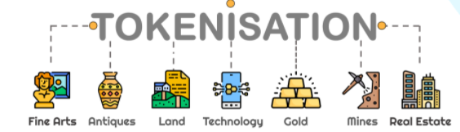
Benefits:
Improve Access to the Market
Automating Processes
Deepens Liquidity
Challenges and Opportunities:
Legal and Regulatory Uncertainty
Confidentiality
Current Illiquidity

Slide 7
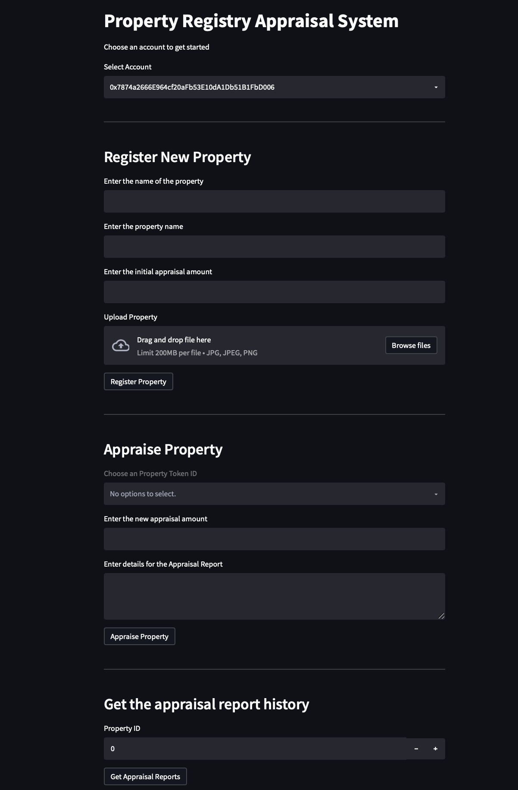

Slide 8
Tokenizing Real Estate _________________________ON THE BLOCKCHAIN DEMO

Slide 9
Take Real Estate Tokenization to the Next Level
Continue to reduce operational complexity
Future of Real Estate Tokenization
Unlock previously unavailable matching opportunities with a rapid time-to-market scale
Notes:
. Additional questions: How to incorporate crowdfunding if we were to split the property up into many tokens and then sell off those tokens. This would essentially turn the tokens into Fungible Tokens.
. Additional topics to research
. Plan for future development: Develop the front end for the auction function. Have a feature for a fixed sale or a Dutch Auction. RP data API to perform an analysis on the property that has been registered so the seller has more information to base their asking price on.

Slide 10
References
Real-estate-tokenization, https://assets.kpmg/content/dam/kpmg/cn/pdf/en/2020/04/real-estate-tokenization.pdf, accessed December 2018
Nareit, “REITWatch: A Monthly Statistical Report on the Real Estate Investment Trust Industry,” March, 2020, https:// www.reit.com/sites/default/files/reitwatch/RW2003.pdf, accessed April 2, 2020
Securities and Futures Commission, “SFC adopts new approach to virtual asset trading platforms,” November, 2019, https:// www.sfc.hk/edistributionWeb/gateway/EN/news-and-announcements/news/doc?refNo=19PR105, accessed April 2, 2020
GitHub, https://github.com/fong1985/Project-3-Token-House.git

